Slide 1
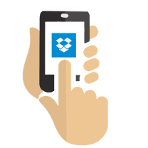
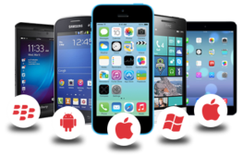
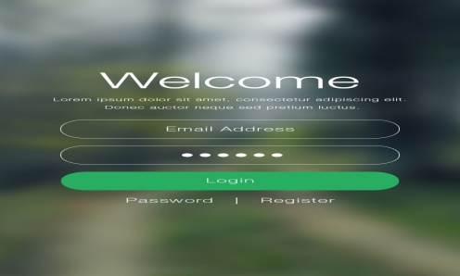



Mobile user
Mobile application
Login page
Book doctor appointment
Book lab test
Order medicines
Track previous orders
Track historical records
Track transactions
Maintain user profile

